Slide 1




The effects of soil chemistry on foliar photosynthetic traits across biomes
Olivia Werba

Slide 2

Background

Slide 3
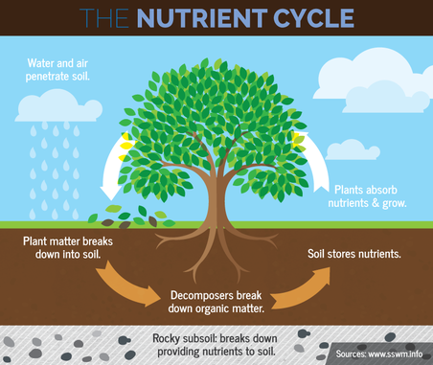



Why soil chemistry?
Critical for understanding environmental biogeochemical processes
Plant growth
Environmental contaminants
https://soil.evs.buffalo.edu/index.php/Main_Page

Slide 4
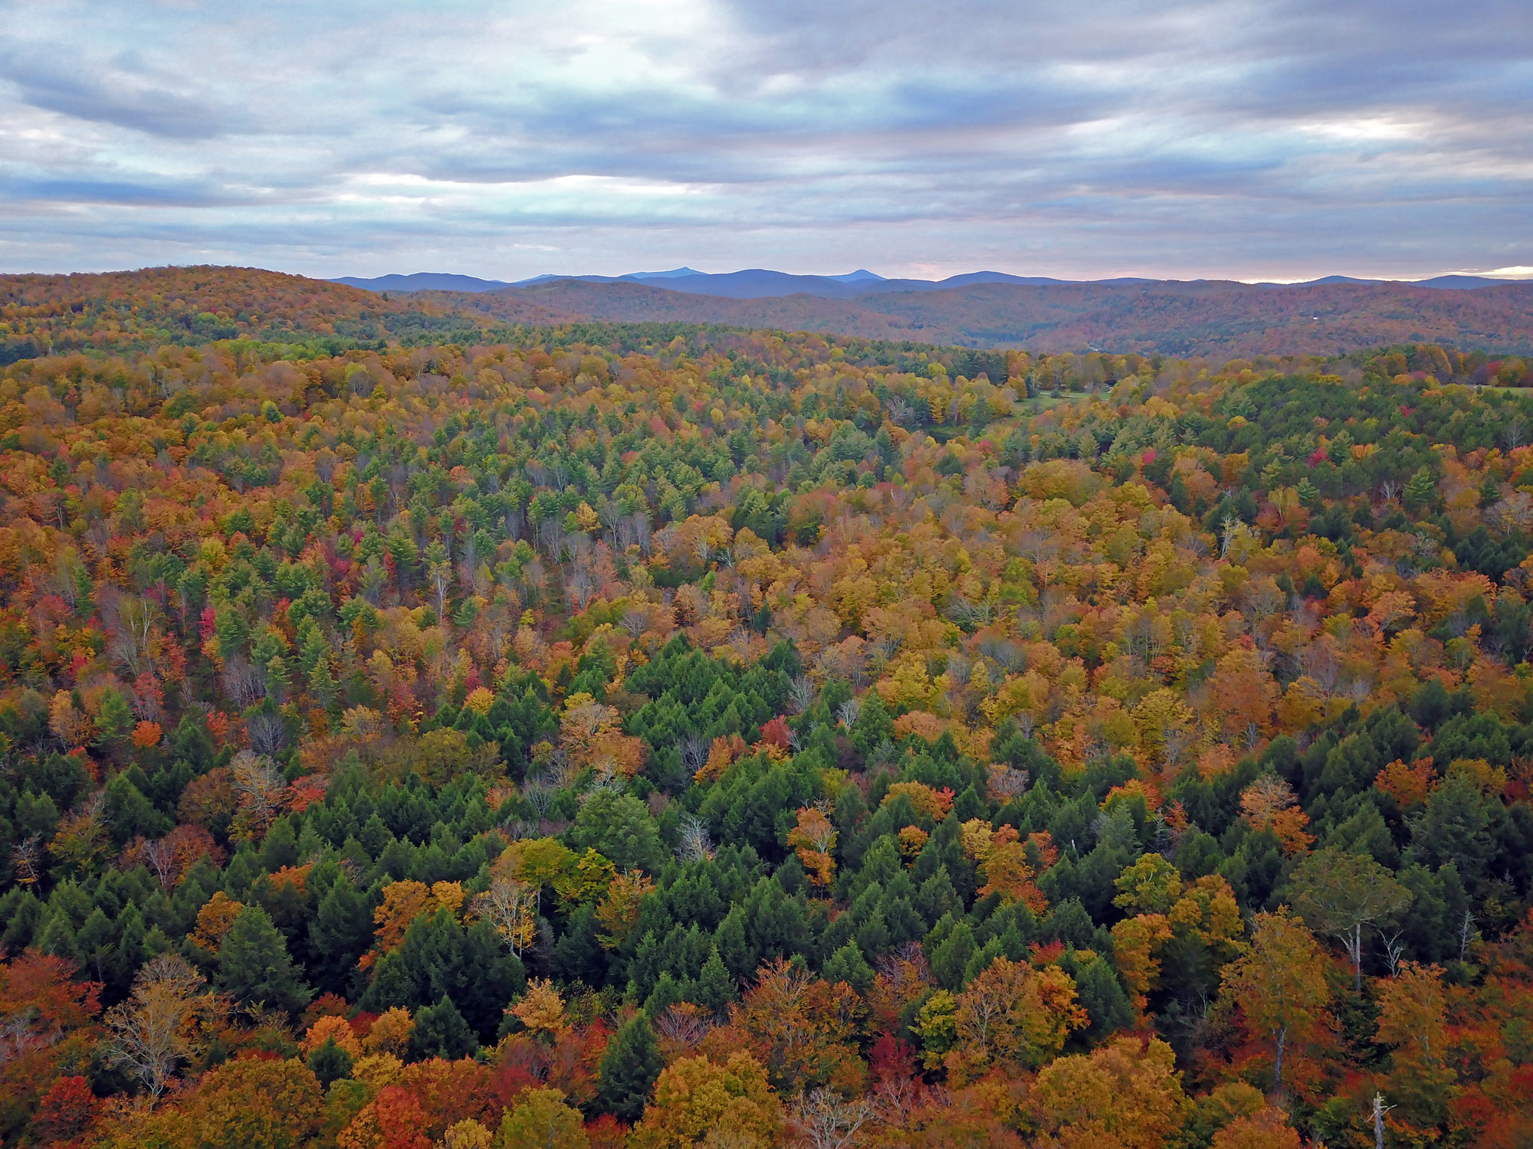

Plant foliar traits
Nutrient concentration
Lignin
Leaf water content
Chlorophyll
Sharron, E. (n.d.). Northeast Temperate Network Ecosystems (U.S. National Park Service). National Parks Service. https://www.nps.gov/im/netn/ecosystems.htm

Slide 5


Ecoclimatic Zones
Vegetation
Landforms
Ecosystem dynamics
20 in the US

Slide 6




Impacts
Understanding plant-soil relationships
View across biomes
Inform larger models

Slide 7

Data

Slide 8

Data
Data from National Science Foundation’s National Ecological Observatory Network (NEON)
Ecosystem monitoring across the US
47 terrestrial field sites
Spatial and temporal data
Lunch, C. K. (n.d.). Neon domain and site shapefiles and maps. NEON Domain and Site Shapefiles and Maps | NSF NEON | Open Data to Understand our Ecosystems. https://www.neonscience.org/resources/learning-hub/tutorials/neon-maps

Slide 9
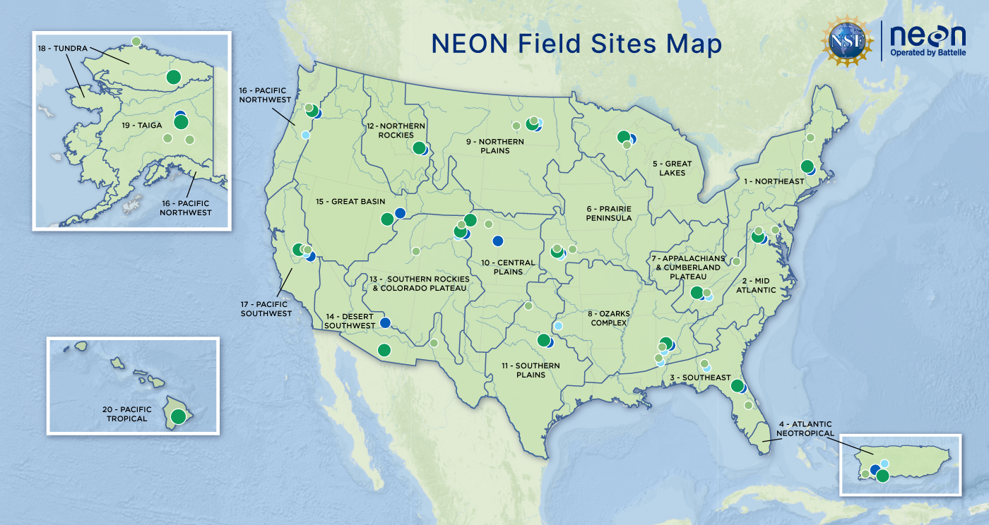
Notes:
Dark green are core sites, light green are gradient sites
Soil physical and chemical data
Photosynthetic data

Slide 10

Approach

Slide 11


Guiding Work Section I
Plant-soil relationships influence observed trends between manganese and carbon across biomes
Global effects of soil and climate on leaf photosynthetic traits and rates
Santos, F., & Herndon, E. (2023). Plant‐soil relationships influence observed trends between manganese and carbon across biomes. Global Biogeochemical Cycles, 37(1). https://doi.org/10.1029/2022gb007412
Maire, V., Wright, I. J., Prentice, I. C., Batjes, N. H., Bhaskar, R., van Bodegom, P. M., Cornwell, W. K., Ellsworth, D., Niinemets, Ü., Ordonez, A., Reich, P. B., & Santiago, L. S. (2015). Global effects of soil and climate on leaf photosynthetic traits and rates. Global Ecology and Biogeography, 24(6), 706–717. https://doi.org/10.1111/geb.12296

Slide 12

Methodology – Section I
Adapt Santos methodology to Python
Examine relationships explored in Maire using a cohesive dataset

Slide 13

Guiding Work Section II
Surface soil properties are linked with climatic and biota properties on a global scale
Zhao, X., Yang, Y., Shen, H., Geng, X., and Fang, J.: Global soil–climate–biome diagram: linking surface soil properties to climate and biota, Biogeosciences, 16, 2857–2871, https://doi.org/10.5194/bg-16-2857-2019, 2019.

Slide 14
Methodology – Section II
Fit the data to different ML classification models
Evaluate the models based on accuracy

Slide 15

Challenges

Slide 16

Challenges
Grouping data by site
Scope shift
Domain specific knowledge
Computing Resources

Slide 17

Results

Slide 18


Results
Confirm Santos Methodology
Soil chemistry & plant photosynthetic traits
Classification of ecoclimatic zones

Slide 19
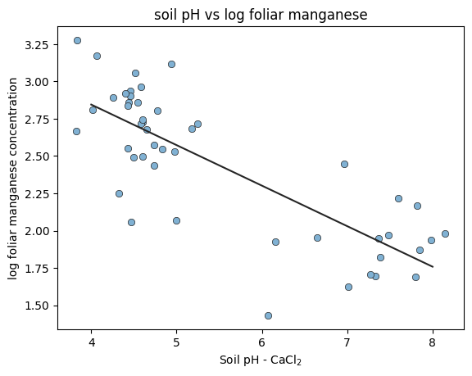
Confirmation of Santos Methodology

Slide 20

Results
Confirm Santos Methodology
Soil chemistry & plant photosynthetic traits
Classification of ecoclimatic zones

Slide 21
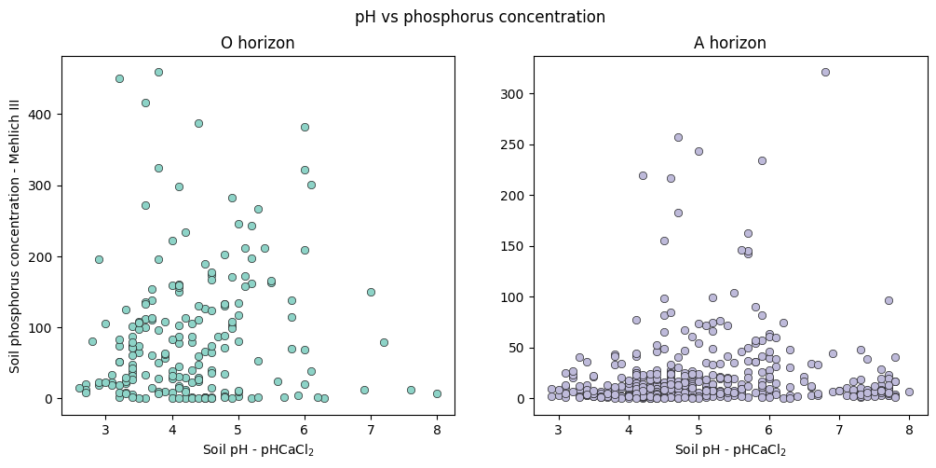
Soil chemistry and plant photosynthetic traits

Slide 22

Results
Confirm Santos Methodology
Soil chemistry & plant photosynthetic traits
Classification of ecoclimatic zones

Slide 23
Classification of ecoclimatic zones

Slide 24
Thank you!

